Slide 1













XVI. International Sport Psychology, Sport, Child and Adolescent Development Conference
June 23-24, 2022 Vienna, Austria
Is football or badminton associated with more positive affect ? The links between affects and sports club membership
among French adolescents
Alexis Barbry¹⁻³, Annie Carton⁴, Jérémy Coquart^{1,3}, Hervé Ovigneur², Camille Amoura³, Williams Nuytens³ and Gabor Orosz³
¹Université de Rouen-Normandie, Centre des Transformations des Activités Physiques et Sportives, Rouen, France
²L’Institut des Rencontres de la Forme, Wattignies, France
³Univ. Lille, Univ. Artois, Univ. Littoral Côte d’Opale, ULR 7369 - URePSSS - Unité de Recherche Pluridisciplinaire Sport Santé Société, Lille, France
⁴Univ. Artois, Univ. Lille, Univ. Littoral Côte d’Opale, ULR 7369 - URePSSS - Unité de Recherche Pluridisciplinaire Sport Santé Société, Liévin, France
Notes:
Firstly, I would like to thank you the organisers of this conference who gave me the opportunity to present our study. It is a great honnor for this multidisciplinary and international team to present the following paper: “Is football or badminton associated with more positive affect ? The links between affects and sports club membershipamong French adolescents.”
I’m going to quickly present myself. My name is Alexis Barbry, I’m a Ph.D. student in the University of Lille in the North of France. I’m working in psychophysiology and I’m interesting about the influence of physical activity on well-being.

Slide 2
SUMMARY
1. Introduction
2. Materials and methods
3. Results
4. Discussion
5. Conclusion
Notes:
Here you can see, the summary of the presentation. I will start with the introduction which is a literature review.

Slide 3
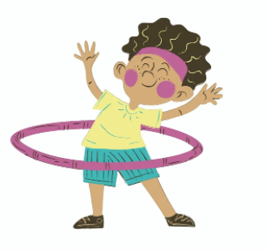



1. INTRODUCTION
2. MATERIALS AND METHODS
3. RESULTS
4. DISCUSSION
5. CONCLUSION
LITTERATURE REVIEW
Effect of physical activity on mental health is unquestionable.
children’s cognitive functioning
Donnely et al. (2016)
Zhang et al. (2020)
negative affectivity
Notes:
A lot of works has shown the positive effect of physical activity on the mental health of adolescents.
For example, the systematic review of Donnelly et al. (2016) found that PA positively impact children’s cognitive functioning. Other work also shown that adolescents who were engaged in PA or sport elevated their positive affects but also reduce the negative ones.

Slide 4

1. INTRODUCTION
2. MATERIALS AND METHODS
3. RESULTS
4. DISCUSSION
5. CONCLUSION
LITTERATURE REVIEW
Characteristics of physical activities and affective benefits.
Influences of sports club participation
Brettschneider (2001)
Positive effect on adolescents’ self- esteem
Howie et al. (2010)
Development of social competence
Notes:
But, the following study will be interested in the influence of a specific type of physical activity which is sports club participation. The literature shown that being a member of a sport clubs seems to have an impact on adolescent self-esteem but also contribute to the development of their social competence.

Slide 5







1. INTRODUCTION
2. MATERIALS AND METHODS
3. RESULTS
4. DISCUSSION
5. CONCLUSION
LITTERATURE REVIEW
Characteristics of physical activities and affective benefits.
vs
Team sports
Individual sports
Pluhar et al. (2019)
Notes:
Pluhar et al. were interested in comparing which types of sport grouping would seem to be associated with a decrease in negative affect. They found that people who practices team sports reported less negative affect compared to their counterparts who practice individual sports. This could be explained by the social aspect of team sports.

Slide 6




1. INTRODUCTION
2. MATERIALS AND METHODS
3. RESULTS
4. DISCUSSION
5. CONCLUSION
LITTERATURE REVIEW
Characteristics of physical activities and affective benefits.
Influences of the place of practice
vs
Lawton et al. (2017) / Pasanen et al. (2018) / Thompson Coon et al. (2011)
Notes:
Other authors have wondered if the influence of the place of physical activities’ practice could impact positive and negative affects. In a systematic review, Thompson Coon et al. found that compared with exercising indoors, exercising in natural environments is associated with an increase of positive affects.

Slide 7



1. INTRODUCTION
2. MATERIALS AND METHODS
3. RESULTS
4. DISCUSSION
5. CONCLUSION
LITTERATURE REVIEW
Characteristics of physical activities and affective benefits.
Influences of the intensity of physical activities
Vigorous
Moderate
Low
Costigan et al. (2019 / Ekkekakis et al. (2000, 2003) / Howie et al. (2020) / Qin et al. (2020)
Notes:
Finally, in order to provide information on the different modalities of practice, it would also seem that all intensities of physical activity have a positive effect on the well-being of the participants. On the other hand, the so-called rigorous activities seem to be associated with a more favorable mental health. A higher frequency and duration of practice lead to better affective benefits.

Slide 8






1. INTRODUCTION
2. MATERIALS AND METHODS
3. RESULTS
4. DISCUSSION
5. CONCLUSION
RESEARCH QUESTION
Which sports club membership could be associated with more or fewer affective benefits ?
Sports club memberships associated with affective benefits
Collective, outdoor and vigorous sports
affective benefits
Individual, indoor and low intensity
affective benefits
Notes:
To our knowledge, we do not know, which sports club membership could be associated with more ou fewer affective benefits ? We will assume, in line with the literature review, that every sports club membership is associated with affective benefits. Collective, outdoor and vigorous sports is going to enhance an increase of affective benefits. It seems unlikely that a single sport will fufill all of these criteria. But some sports, such as soccer, athletics, and basketball could meet most of them.

Slide 9





1. INTRODUCTION
2. MATERIALS AND METHODS
3. RESULTS
4. DISCUSSION
5. CONCLUSION
POPULATION AND MEASURES
Population
12,849 adolescents (i.e. 10-18 years old)
5,812
7,037
Measures
Are you a member of a sports club ?
Positive and negative affects questionnaire
Notes:
Our population is composed of more than 10 thousand French adolescents who were recruited during the physical education classes. The physical education teachers asked to the participant if they were engaged in a sport club. If the answer was, yes, the teenagers need to give the sport. Only one sport could be given. Then, they passed a physical fitness test and finally they reported a positive and negative affects questionnaire, 30 minutes after the Diagnoform® program.

Slide 10

1. INTRODUCTION
2. MATERIALS AND METHODS
3. RESULTS
4. DISCUSSION
5. CONCLUSION
POPULATION AND MEASURES
In the last 3-4 days, how often did you experience these affects ?
+++
---
Joyful
Enthusiastic
Proud
Full-of-energy
Happy
Angry
Sad
Anxious
Ashamed
Guilty
Annoyed
Worried
A confirmatory factor analysis showed that positive and negative scales have excellent internal consistency values
Carton et al. (2021)
Notes:
Participants were requested to describe the extent they experienced a set of positive and negative affects in the past 3-4 days ? Responses were provided on a five-point Lickert scale ranging form 1 (not at all) to 5 (very much).

Slide 11





1. INTRODUCTION
2. MATERIALS AND METHODS
3. RESULTS
4. DISCUSSION
5. CONCLUSION
ANALYTIC STRATEGY
Normality of the distribution
Shapiro-Wilk test
Post-hoc test
Benjamini-Hochberg
ANalysis Of VAriance
One-way ANOVA determine affect differences in sports
Notes:
The Benjamini-Hochberg post-hoc test is a modified version of the Bonferroni correction for a high number of hypothesis testing.

Slide 12
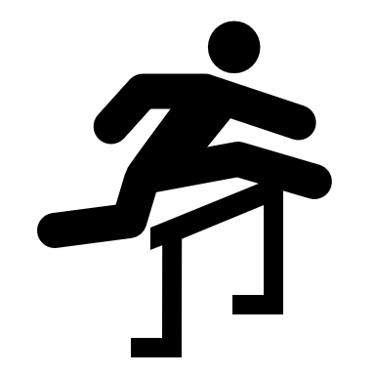

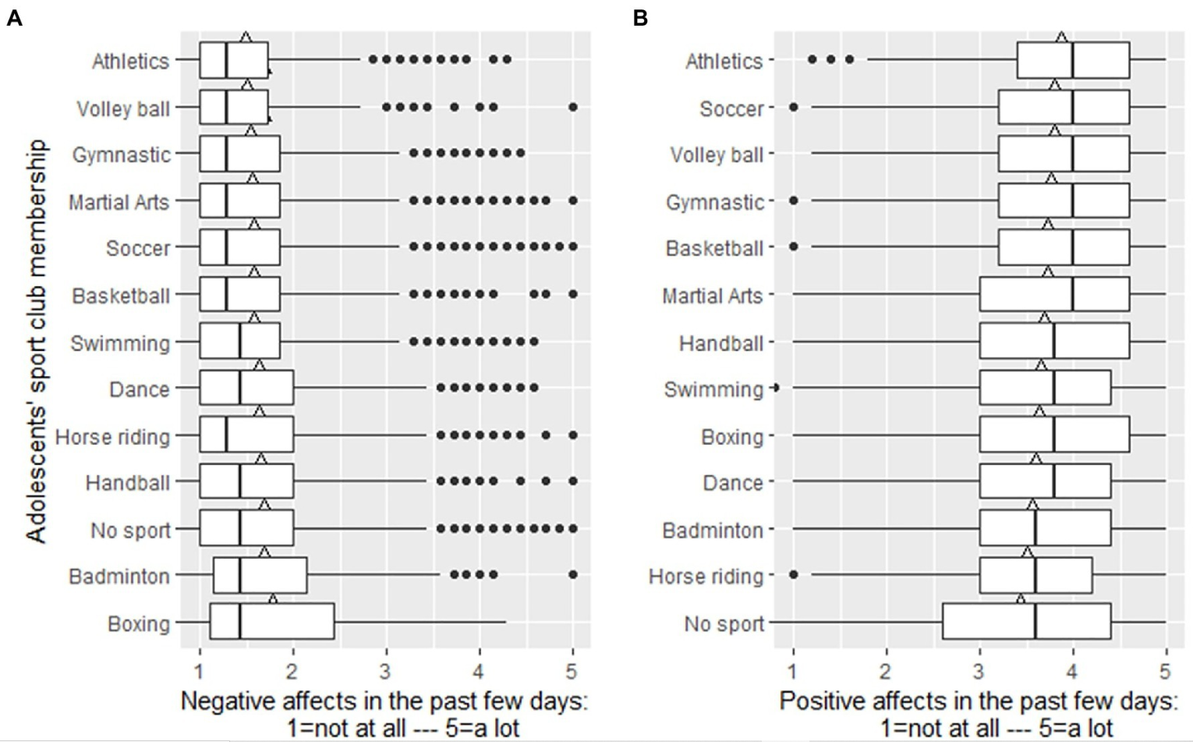





1. INTRODUCTION
2. MATERIALS AND METHODS
3. RESULTS
4. DISCUSSION
5. CONCLUSION
Figure 1. Negative and positive affects among the most practiced French sports club memberships
+++
---
Notes:
Our results suggested that teens who practiced athletics reported lower negative affects compared to the teenagers who practiced others sports. In the same direction, adolescents who were engaged in an athletic and soccer club reported more positive affects compared to the other sport. Some sports, such as Bowing, Badminton, Horse riding and dance seem to be associated with a decrease of affective benefits compared to other sports. LFinally, as we expected teeanagers who are not engaged in a sport club reported fewer positive affects.

Slide 13
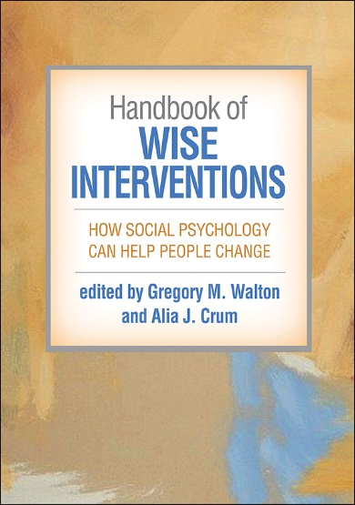
1. INTRODUCTION
2. MATERIALS AND METHODS
3. RESULTS
4. DISCUSSION
5. CONCLUSION
SPORTS CLUB PARTICIPATION
Adolescents who practised sport in a sports club reported more positive affects and less negative ones
Opportunities to build, extend and reinforce their social network
Howie et al. (2010)
Satisfy their need to belong
Baumeister et Leary (1995)
Notes:
Firstly, as we expected adolescents who were engaged in a SC reported more affective benefits compared to those not engaged in a SC. In addition to the influence of physical activity on the well-being of adolescents mentioned in the literature review, the practice of sports in clubs seems to be an opportunity to build and strengthen these social relationships. Thus, allowing the need to belong to be satisfied. And potentially increase the affective benefits of adolescents.

Slide 14
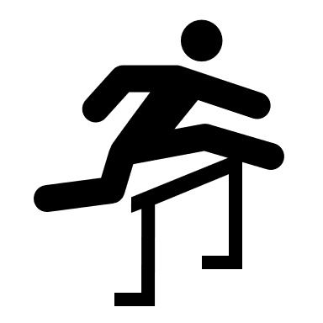

1. INTRODUCTION
2. MATERIALS AND METHODS
3. RESULTS
4. DISCUSSION
5. CONCLUSION
SPORTS WITH MORE AFFECTIVE BENEFITS
The result is surprising as it is an individual sport
BUT
Vigorous
Gernigon (1998)
Notes:
Adolescents belonging to an athletics club reported the highest positive and lowest negative affects among examinded groups. The current result is a little surprising as it is an individual sport. However, we assume that teens in athletic clubs participate very often in competition which reflect a high level of motivation. The people who practices competition need to have an important frequency, intensity and duration of practice. Moreover, athletic is an outdoor sport which is associated with an increase of positive affects compared to negative ones. Athletics appear to accumulate multiple sources of affective benefits. Most researches could be done to explain this result.

Slide 15


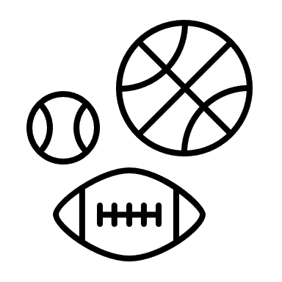

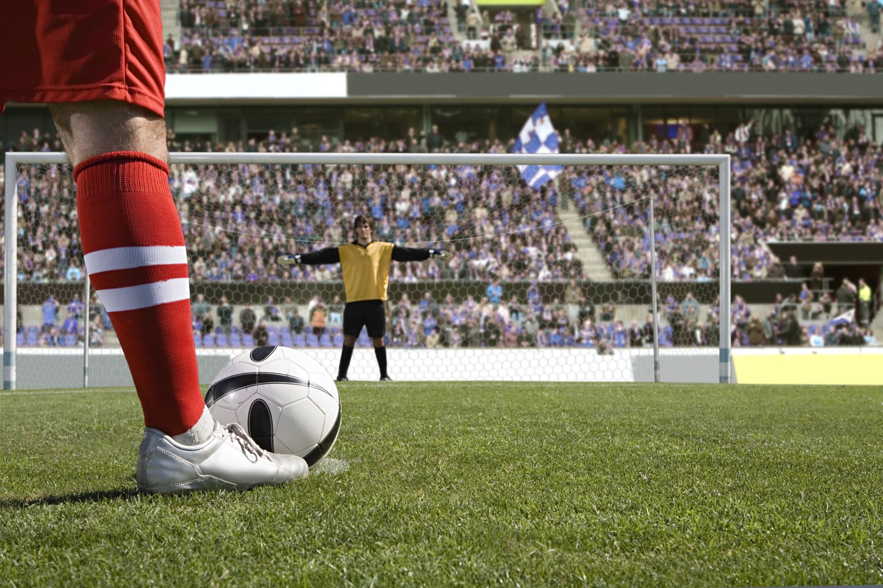
1. INTRODUCTION
2. MATERIALS AND METHODS
3. RESULTS
4. DISCUSSION
5. CONCLUSION
SPORTS WITH MORE AFFECTIVE BENEFITS
Team sports lead to extra affective benefits
Guddal et al. (2019) / Pluhar et al. (2019)
Soccer is an outdoor sport
Lawton et al. (2017) / Thompson Coon et al. (2011)
Strong identification with the famous French national team
Notes:
Another sport seem to be associated with affective benefits: Soccer which is a team sports that lead to extra affective benefits. Moreover, soccer is an outdoor sport and outdoord sport are well known to increase positive affects.
Another hypothesis we could suggest is that adolescent soccer players identify strongly with the French football team, which is still the reigning world champion. This identification could potentially influence their affective responses.

Slide 16






1. INTRODUCTION
2. MATERIALS AND METHODS
3. RESULTS
4. DISCUSSION
5. CONCLUSION
SPORTS WITH LESS AFFECTIVE BENEFITS
Indoor sports
Lawton et al. (2017)
Harsh dietary strategies
Hall et Lane (2001)
Aesthetic sport
Increasing weight concern
Davison et al. (2002)
Notes:
As mentioned in the result section, some sports seem to be associated with less affective benefits.
Most of them are indoor sports which is associated with less affective benefits. For example, boxers often experienced intense negative mood maybe due to the harsh dietary strategies to lose weight before competitions.
Dance is an aesthetic sport which is associated with an increase level of weight concern that enhance negative emotions.

Slide 17
1. INTRODUCTION
2. MATERIALS AND METHODS
3. RESULTS
4. DISCUSSION
5. CONCLUSION
30 minutes after the physical fitness test
LIMITATIONS
Only one sport could be declared
Ask the participants about intensity, frequency and volume of physical activities
PERSPECTIVES
Other validated tools such as the PANAS (Watson et al., 2008) could be used

Slide 18


1. INTRODUCTION
2. MATERIALS AND METHODS
3. RESULTS
4. DISCUSSION
5. CONCLUSION
Being a member of a sports club is associated with affective benefits
Athletics and soccer club membership might be associated with the highest level of affective benefits
Boxing, badminton, dance and horse riding are associated with less benefits
FULL TEXT LINKS
Notes:
The present one is a pioneering, large scale study that might provide broader guidelines for future scientific investigations in the field.

Slide 19
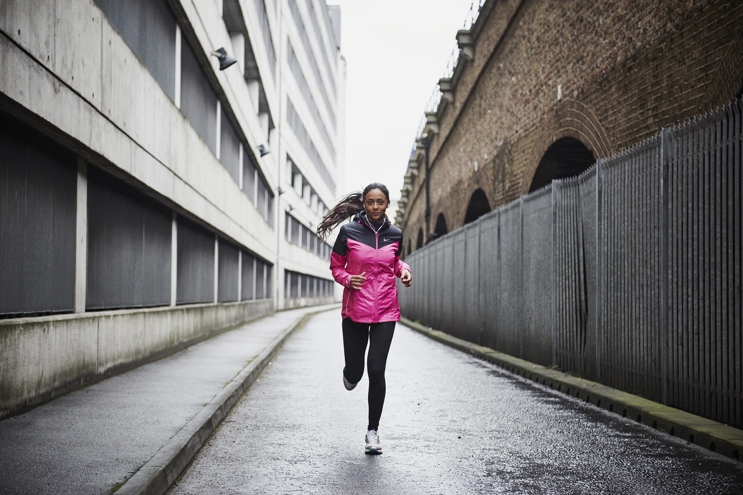
ACKNOWLEDGMENT
The authors are grateful to the for making the data available
THANK YOU FOR YOUR ATTENTION

